Slide 1
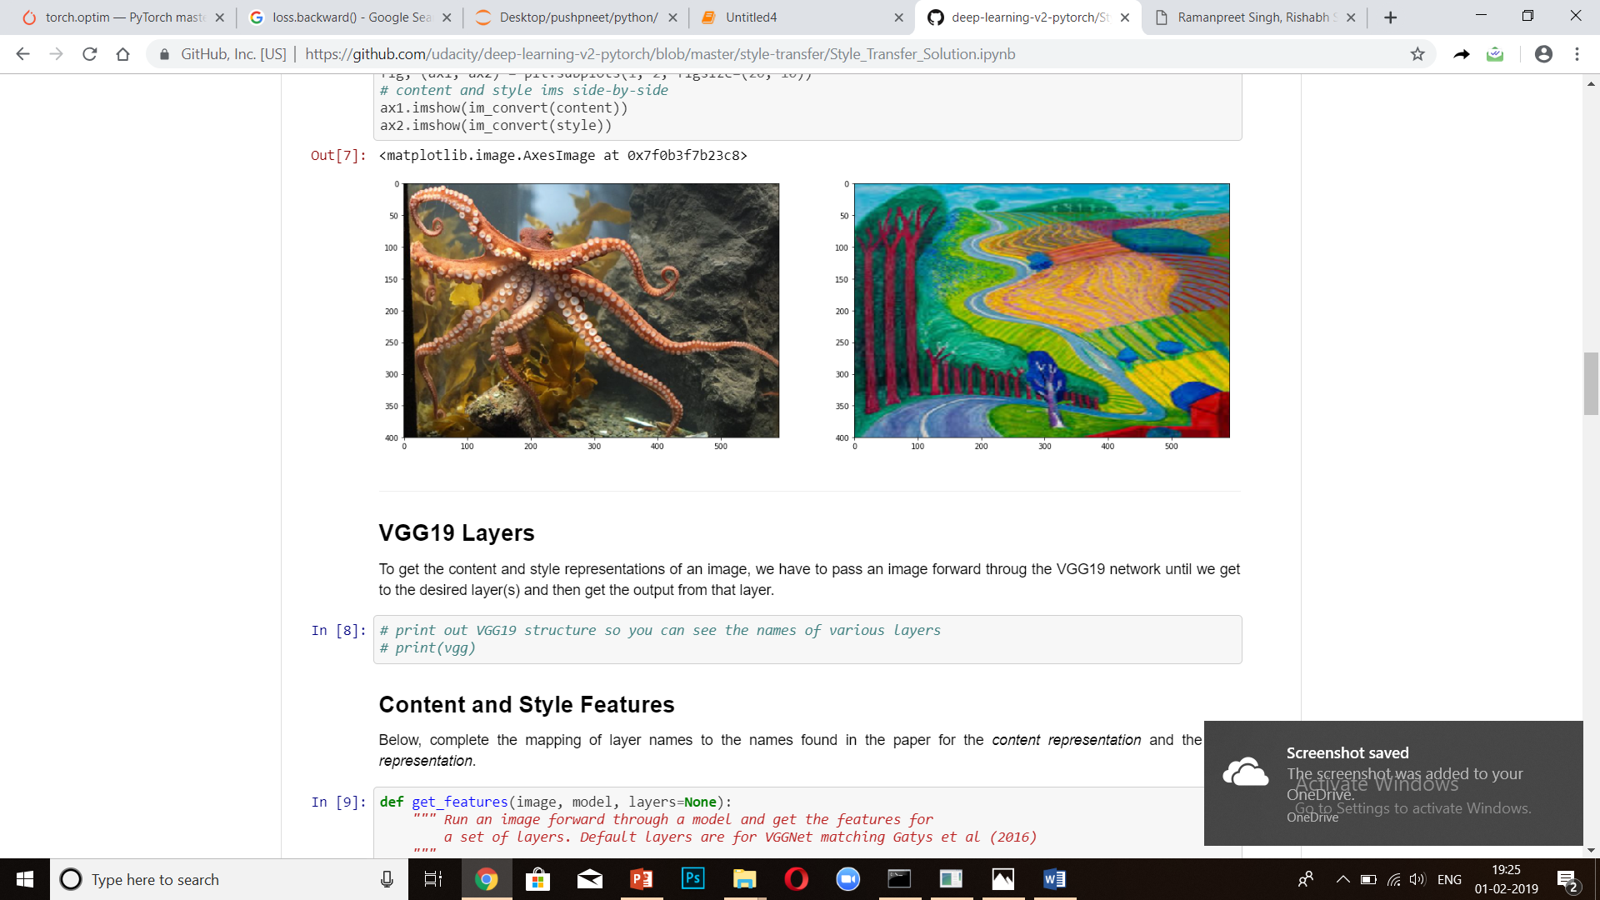
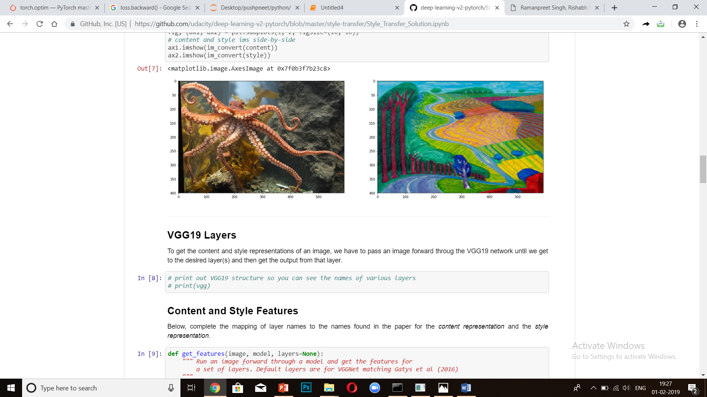
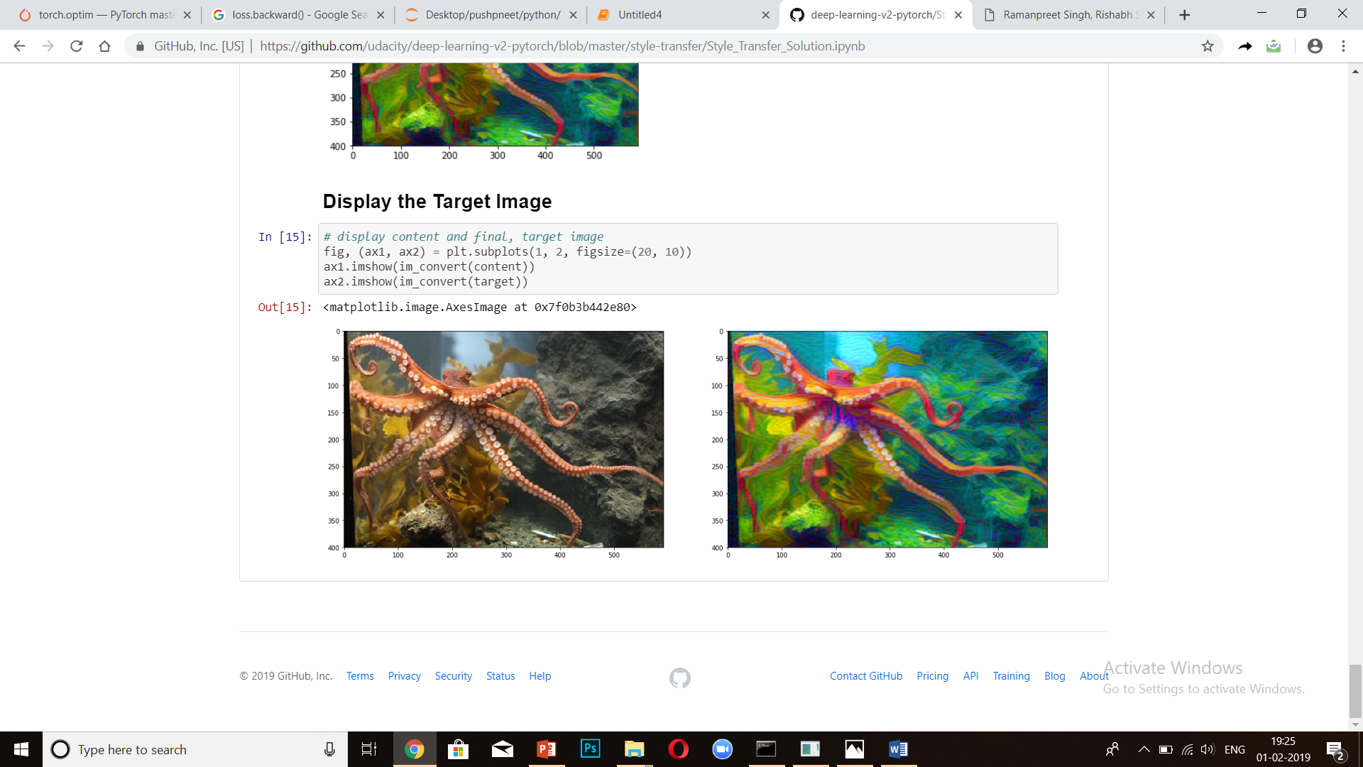
Neural Image Style Transfer
Team members
Ramanpreet Singh
Rishab Sharma
Pushpneet Singh
+
=

Slide 2
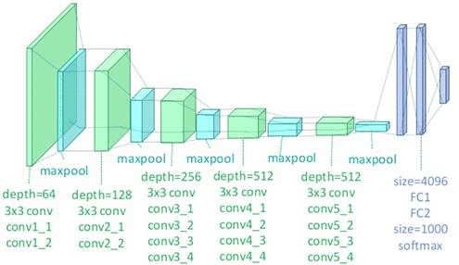
Style Transfer will use the features found in the VGG 19 cnn model , which is comprised of a series of convolutional and pooling layers, and a few fully connected layers. Style Transfer relies on seperating the content and style of an image. Given one content image and one style image, we aim to create a new, target image which should contain our desired content and style components.
Objects and their arrangement are similar to that of the content image.
Style, colors and textures are similar to that of the style image.

Slide 3
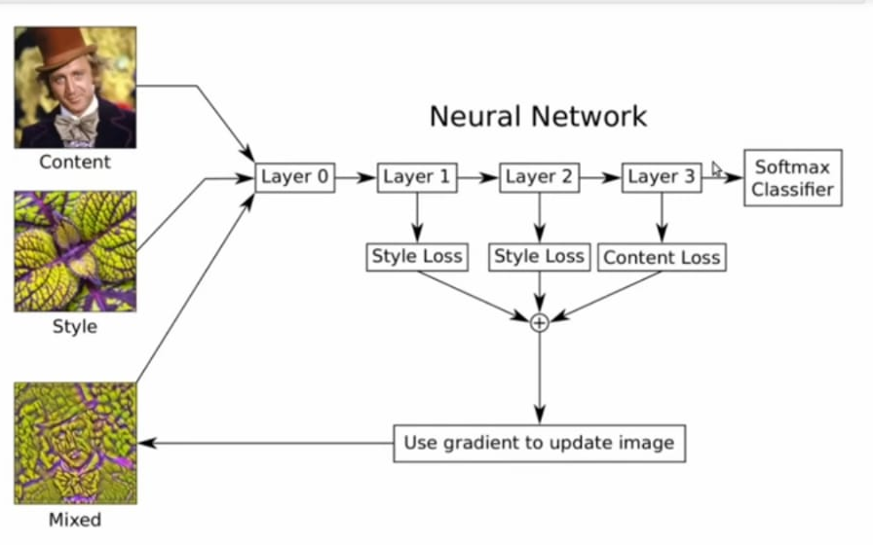
We will use a pretrained VGG-19 network to extract content or style features from a passed in image .We will then formalize the idea of content and style losses using backpropagation to minimize the defined loss function between our target and intent image and use those to iteratively update our target image until we get a result that we want .

Slide 4
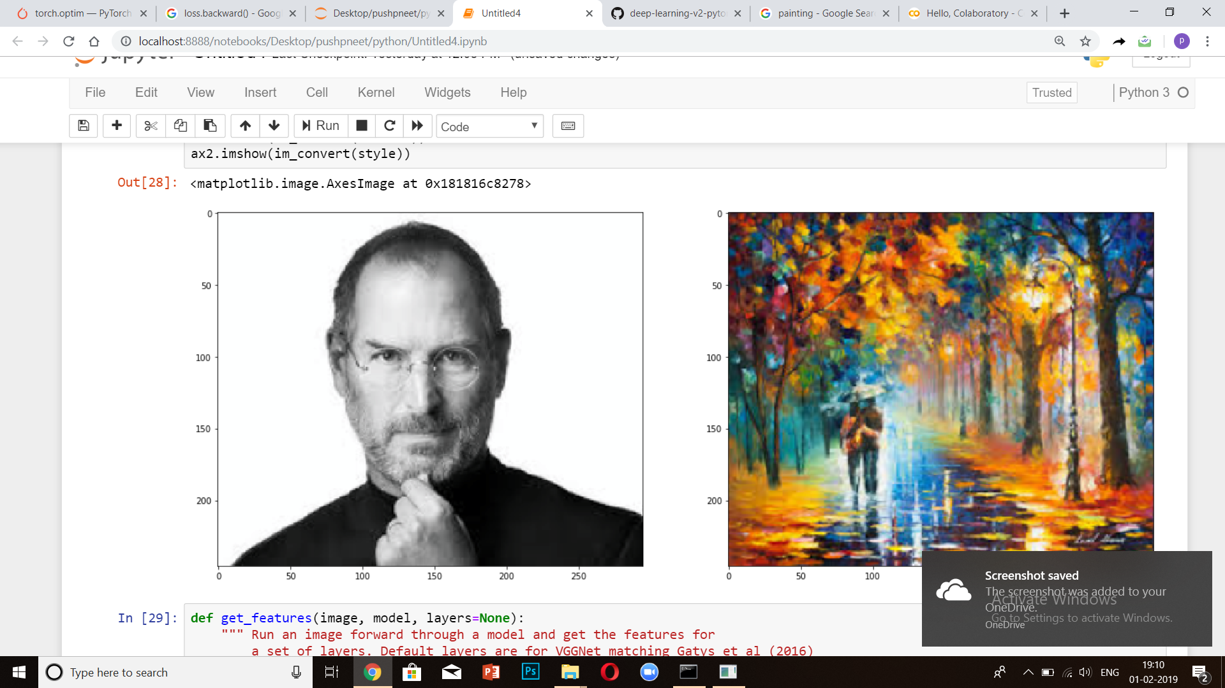
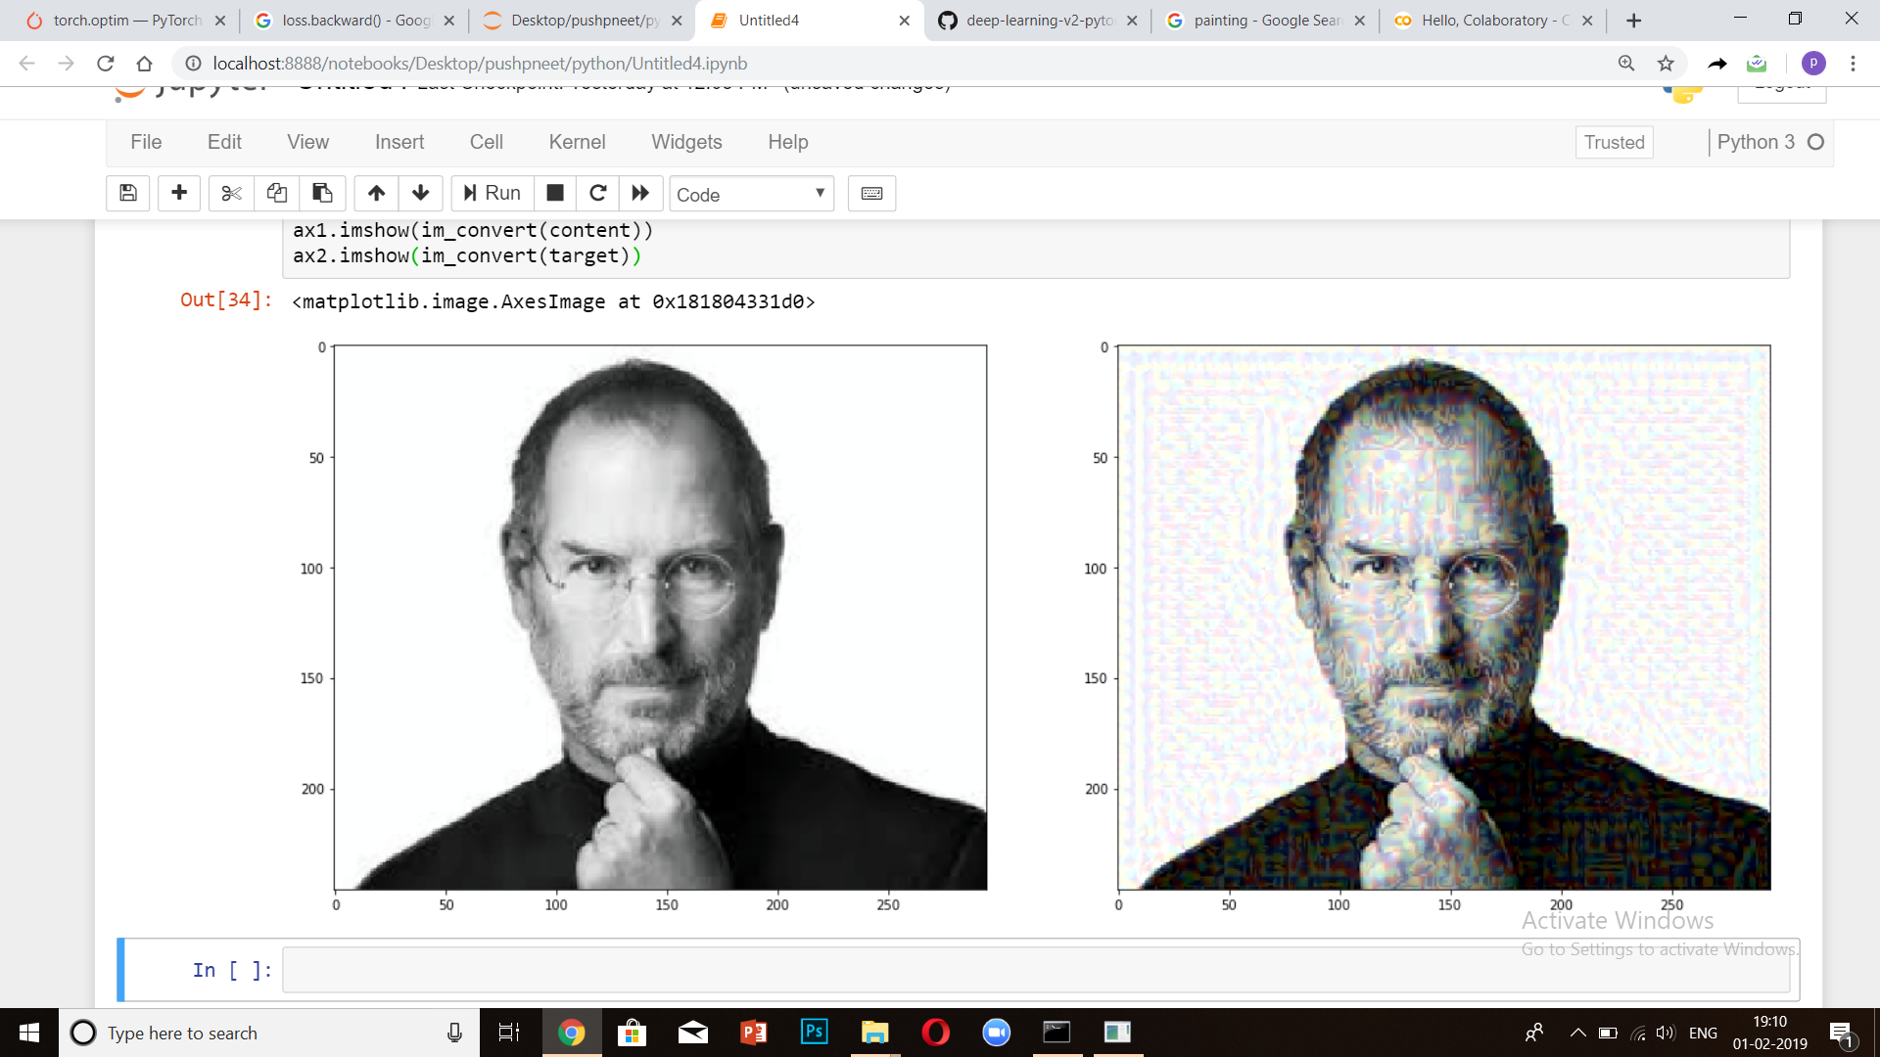
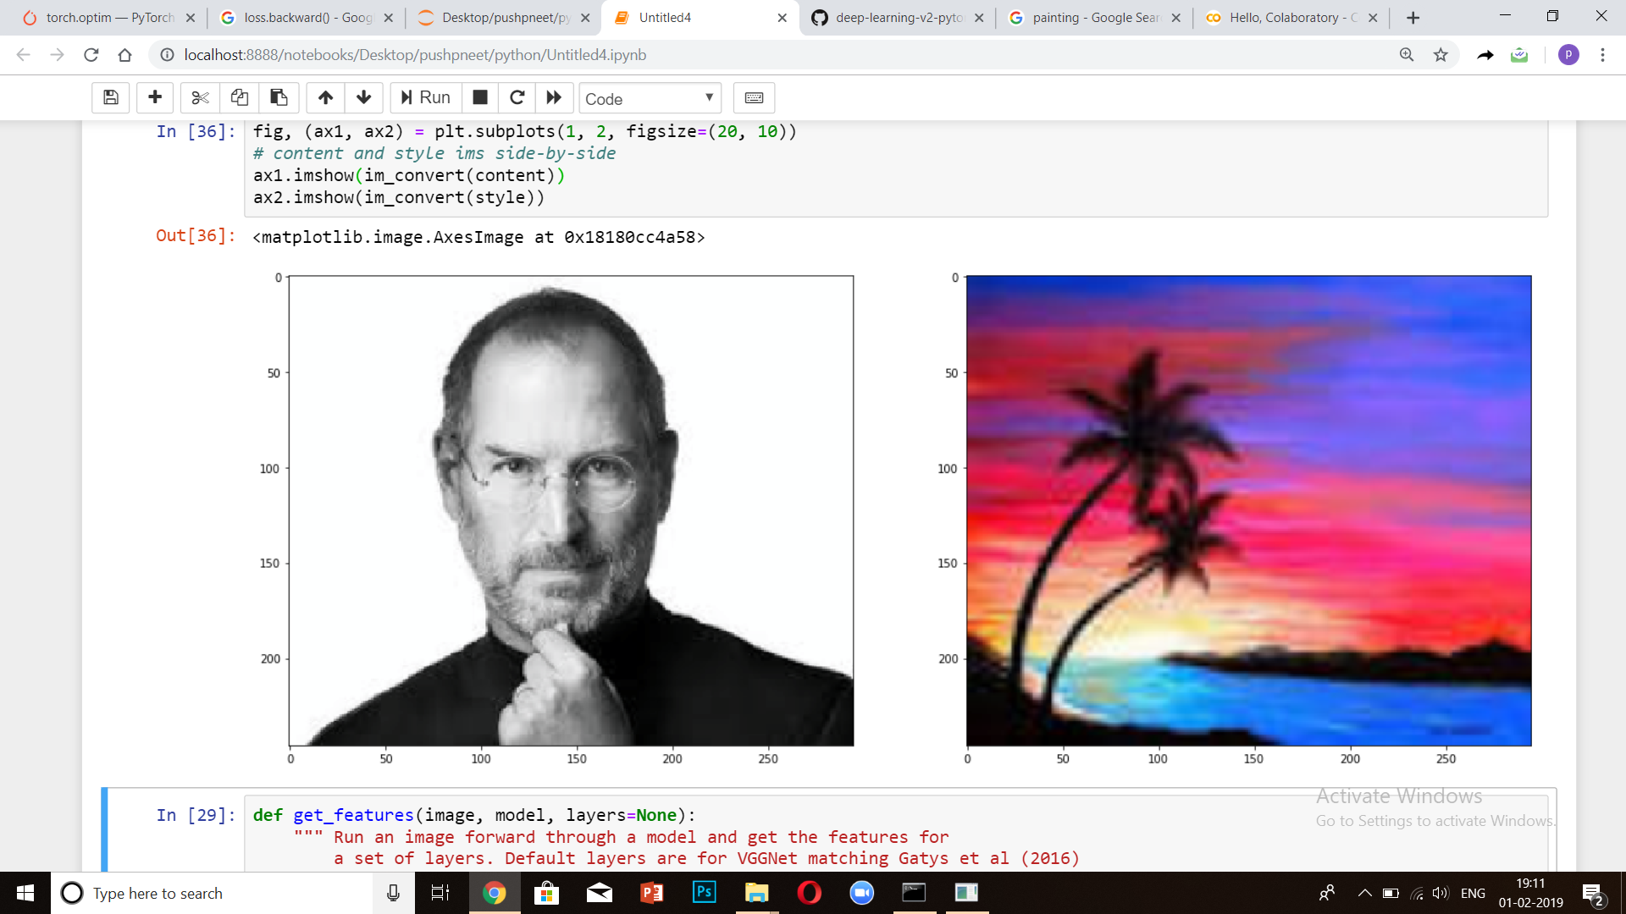
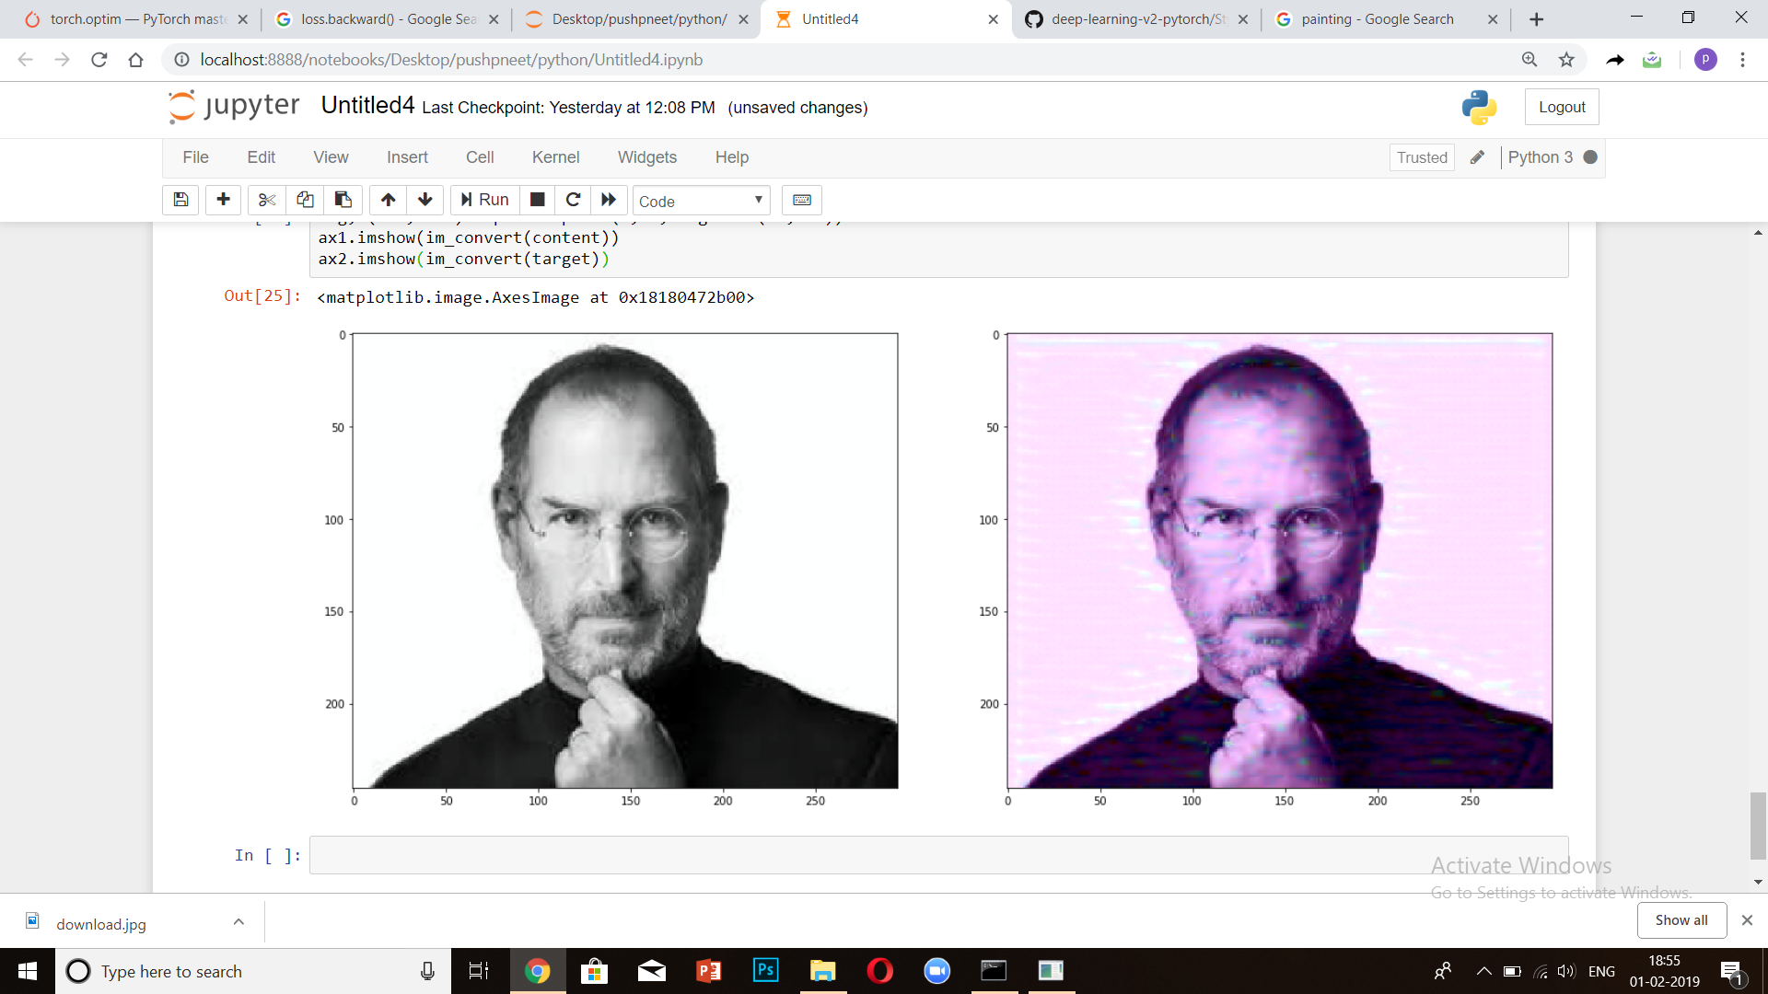
Result

Slide 5
Now
code

